Slide 1


AkiliSpa Mental Health
Addressing Mental Health Challenges: An SDG 3 Initiative
This presentation outlines a project focused on improving mental well-being through data-driven insights. We aim to leverage data analysis to understand and address the challenges related to mental health, contributing to Sustainable Development Goal 3, ensuring healthy lives and promoting well-being for all.
by Marklewis Ngondi

Slide 2
Project Overview and SDG Alignment
Goal 3: Health and Well-being
Data-driven Approach
This project directly addresses target 3.4, which aims to reduce premature mortality from non-communicable diseases, including mental health conditions.
Our project utilizes data analysis to gain deeper insights into mental health trends and identify areas for improvement.

Slide 3

Problem Definition and Significance
Mental Health Burden
Limited Access to Resources
Mental health conditions affect a significant portion of the global population, causing a substantial burden on individuals, families, and societies.
Many individuals lack access to adequate mental health care, leading to delayed diagnosis, insufficient treatment, and worsening outcomes.
Socioeconomic Impact
Mental health issues can significantly impact productivity, education, and social participation, contributing to economic and societal burdens.

Slide 4

Database Design and Schema
Fields
Description
Patient Demographics
Age, Gender, Location, Education
Mental Health Conditions
Diagnosis, Severity, Treatment History
Access to Care
Type of Services, Provider Information, Treatment Duration
Socioeconomic Factors
Income, Employment Status, Social Support Network

Slide 5

Data Collection and Preprocessing
Data Sources
Data Cleaning
Data is collected from various sources, including medical records, surveys, and online platforms, ensuring a comprehensive understanding of mental health trends.
Raw data is thoroughly cleaned and preprocessed to ensure accuracy, consistency, and completeness, preparing it for analysis.
Data Integration
Different datasets are integrated into a single, cohesive database, enabling a holistic view of mental health challenges.

Slide 6
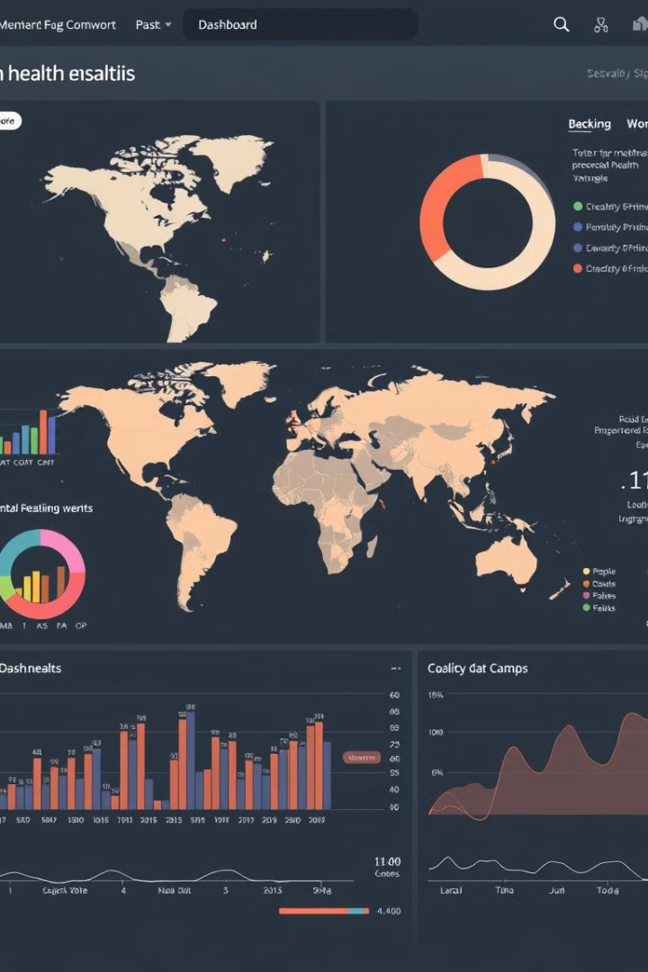



Exploratory Data Analysis
Descriptive Statistics
Data Visualization
Descriptive statistics provide key insights into the characteristics of the data, including means, medians, and frequencies.
Visualizations, such as histograms, scatter plots, and heatmaps, help identify patterns, correlations, and outliers in the data.
Trend Analysis
Analyzing data trends over time provides valuable insights into the prevalence, severity, and treatment patterns of mental health conditions.

Slide 7

Statistical Modeling and Insights
1
Regression Analysis
Regression models are used to identify factors contributing to mental health outcomes and estimate the strength of their influence.
2
Machine Learning Algorithms
Machine learning algorithms can be applied to predict mental health risks and identify individuals who might benefit from early intervention.
3
Data-driven Insights
The analysis provides valuable insights into the factors influencing mental health, guiding the development of targeted interventions and policies.

Slide 8
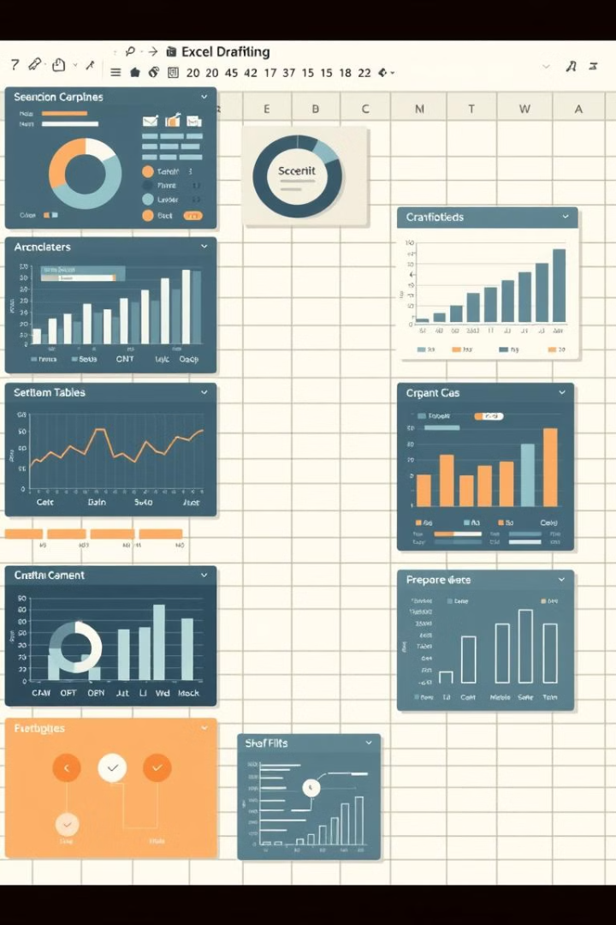




Excel Dashboard Demonstration
Data Visualization
The dashboard presents key findings through visually appealing charts and graphs, facilitating easy understanding of the data.
Interactive Filtering
The dashboard allows users to filter and explore the data by various parameters, such as age, gender, and location, for deeper analysis.
Real-time Updates
The dashboard can be updated with new data as it becomes available, ensuring that insights are always current and relevant.
Decision Support
The dashboard provides a comprehensive overview of mental health trends and key insights, supporting decision-making for effective interventions and policies.

